Slide 1
www.hndit.com
Introduction to Trees
IT12112
Lecture 05

Slide 2
Introduction
www.hndit.com
Tree is one of the most important non-linear data structures in computing. It allows us to implement faster algorithms( compared with algorithms using linear data structures).
Application areas are :
A popular one is the directory structure in many common operating systems, including Unix and DOS etc.
Almost all operating systems store files in trees or tree like structures.
Compiler Design/Text processing
Searching Algorithms
Evaluating a mathematical expression.
Analysis of electrical circuits.

Slide 3
Introduction to Tree
www.hndit.com
Fundamental data storage structures used in programming.
Combines advantages of an ordered array and a linked list.
Searching as fast as in ordered array.
Insertion and deletion as fast as in linked list.

Slide 4
Tree characteristics
www.hndit.com
Consists of nodes connected by edges.
Nodes often represent entities (complex objects) such as people, car parts etc.
Edges between the nodes represent the way the nodes are related.
Its easy for a program to get from one node to another if there is a line connecting them.
The only way to get from node to node is to follow a path along the edges.

Slide 5
Tree Terminology
Path: Traversal from node to node along the edges results in a sequence called path.
Root: Node at the top of the tree.
Parent: Any node, except root has exactly one edge running upward to another node. The node above it is called parent.
Child: Any node may have one or more lines running downward to other nodes. Nodes below are children.
Leaf: A node that has no children.
Subtree: Any node can be considered to be the root of a subtree, which consists of its children and its children’s children and so on.

Slide 6
Tree Terminology (cont.)
www.hndit.com
Sibling
Ancestor
Descendant
Path of two nodes
Length of a path

Slide 7
Tree Terminology (cont.)
www.hndit.com
A
Node or vertex - the labeled squares
Edge -the connecting lines
In the General tree to the right:
  B is the child of A - A is parent of B
  B and C are siblings
  A is the root of the tree
  B and its children (D, E, F) are a subtree of A
The parent-child relationship is generalized as ancestor -descendant.
  B is a descendant of A - A is ancestor to B
B
C
D
E
F

Slide 8
Tree Terminology (cont.)
www.hndit.com
Visiting: A node is visited when program control arrives at the node, usually for processing.
Traversing: To traverse a tree means to visit all the nodes in some specified order.
Levels: The level of a particular node refers to how many generations the node is from the root. Root is assumed to be level 0.
Keys: Key value is used to search for the item or perform other operations on it.

Slide 9
Trees
E.g.
www.hndit.com
Jane
mystuff
Mat
Jennifer
Brian
home
work
Susan
Jerry
Jack
games
teaching
research
Jane’s children and grandchildren
DAS.ppt
OS.ppt
File organization in a computer

Slide 10
Tree Types
www.hndit.com
  Binary tree — each node has at most two children
  General tree — each node can have an arbitrary number of children.
  Binary search trees
  AVL trees

Slide 11
General Trees.
www.hndit.com
Trees can be defined in two ways :
Recursive
Non- recursive
One natural way to define a tree is recursively

Slide 12
General trees-Definition
www.hndit.com
A tree is a collection of nodes. The collection can be empty; otherwise a tree consists of a distinguish node r, called root, and zero or more non-empty (sub)trees T₁,T₂,T₃,….T_{K.} . Each of whose roots are connected by a directed edge from r.

Slide 13
General trees-Definition
www.hndit.com
A tree consists of set of nodes and set of edges that connected pair of nodes.
A
B
C
D
E
F
G
H
J
I
K

Slide 14
E.g. A table of contents and its tree representation
www.hndit.com
Book
  C1
    S1.1
    S1.2
  C2
    S2.1
      S2.1.1
      S2.1.2
    S2.2
    S2.3
  C3
Book
C1
C2
C3
S1.1
S1.2
S2.1
S2.2
S2.3
S2.1.1
S2.1.2

Slide 15
www.hndit.com
Degree : The number of sub tree of a node is called its degree.
E.g. Degree of book → 3, C1→2,C3→0
Nodes that have degree 0 is called Leaf or Terminal node. Other nodes called non-terminal nodes. E.g.Leaf nodes :C3,S1.1,S1.2 etc.
Book is said to be the father (parent) of C1,C2,C3 and C1,C2,C3 are said to be sons (children ) of book.
Children of the same parent are said to be siblings. E.g.C1,C2,C3 are siblings (Brothers)
Length : The length of a path is one less than the number of nodes in the path.
E.g. path from book to s1.1=3-1=2

Slide 16
If there is a path from node a to node b , then a is an ancestor of b and b is descendent of a.
In above example, the ancestor of S2.1are itself,C2 and book, while it descendent are itself, S2.1.1 and S2.1.2.
An ancestor or descendent of a node, other than the node itself is called a proper ancestor or proper descendent.
Height of a tree — the maximum depth of a leaf node. ..[ In above example height=3]
Depth of a node — the length of the path between the root and the node.[In above example node C1 has Depth 1, node S2.1.2 has Depth 3.etc.]
www.hndit.com

Slide 17
Binary Trees
www.hndit.com
A binary tree is a finite set of nodes that is
either empty or consists of a root and two
disjoint binary trees called the left subtree
and the right subtree.
Any tree can be transformed into binary tree.
  by left child-right sibling representation
The left subtree and the right subtree are distinguished.

Slide 18
Left child-right child tree representation of a tree
www.hndit.com
A
B
E
C
G
D
K
F
H
L
M
I
J

Slide 19
Samples of Trees
www.hndit.com
Complete Binary Tree
A
A
1
A
B
B
2
B
C
C
Skewed Binary Tree
3
D
E
F
G
D
4
H
I
E
5

Slide 20
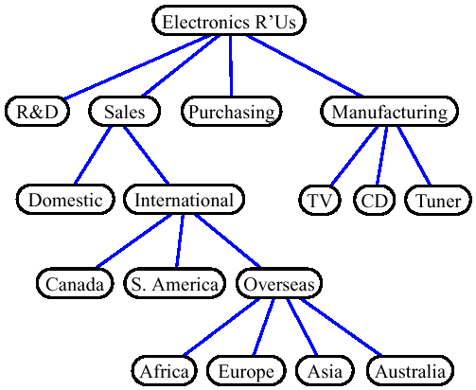
Trees
www.hndit.com
A rooted tree is a connected, acyclic, undirected graph

Slide 21
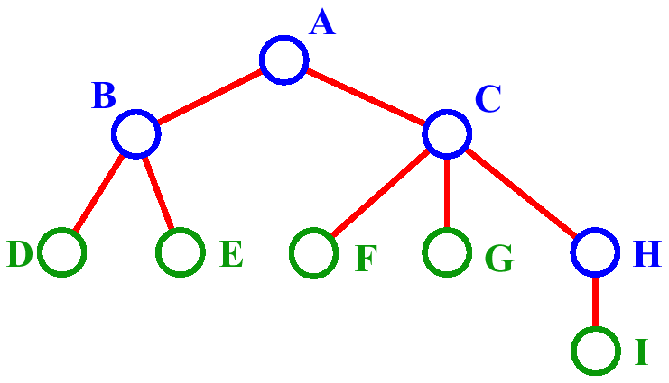
Trees
www.hndit.com
A is the root node.
B is the parent of D and E. A is ancestor of D and E. D and E are descendants of A.
C is the sibling of B
D and E are the children of B.
D, E, F, G, I are leaves.

Slide 22
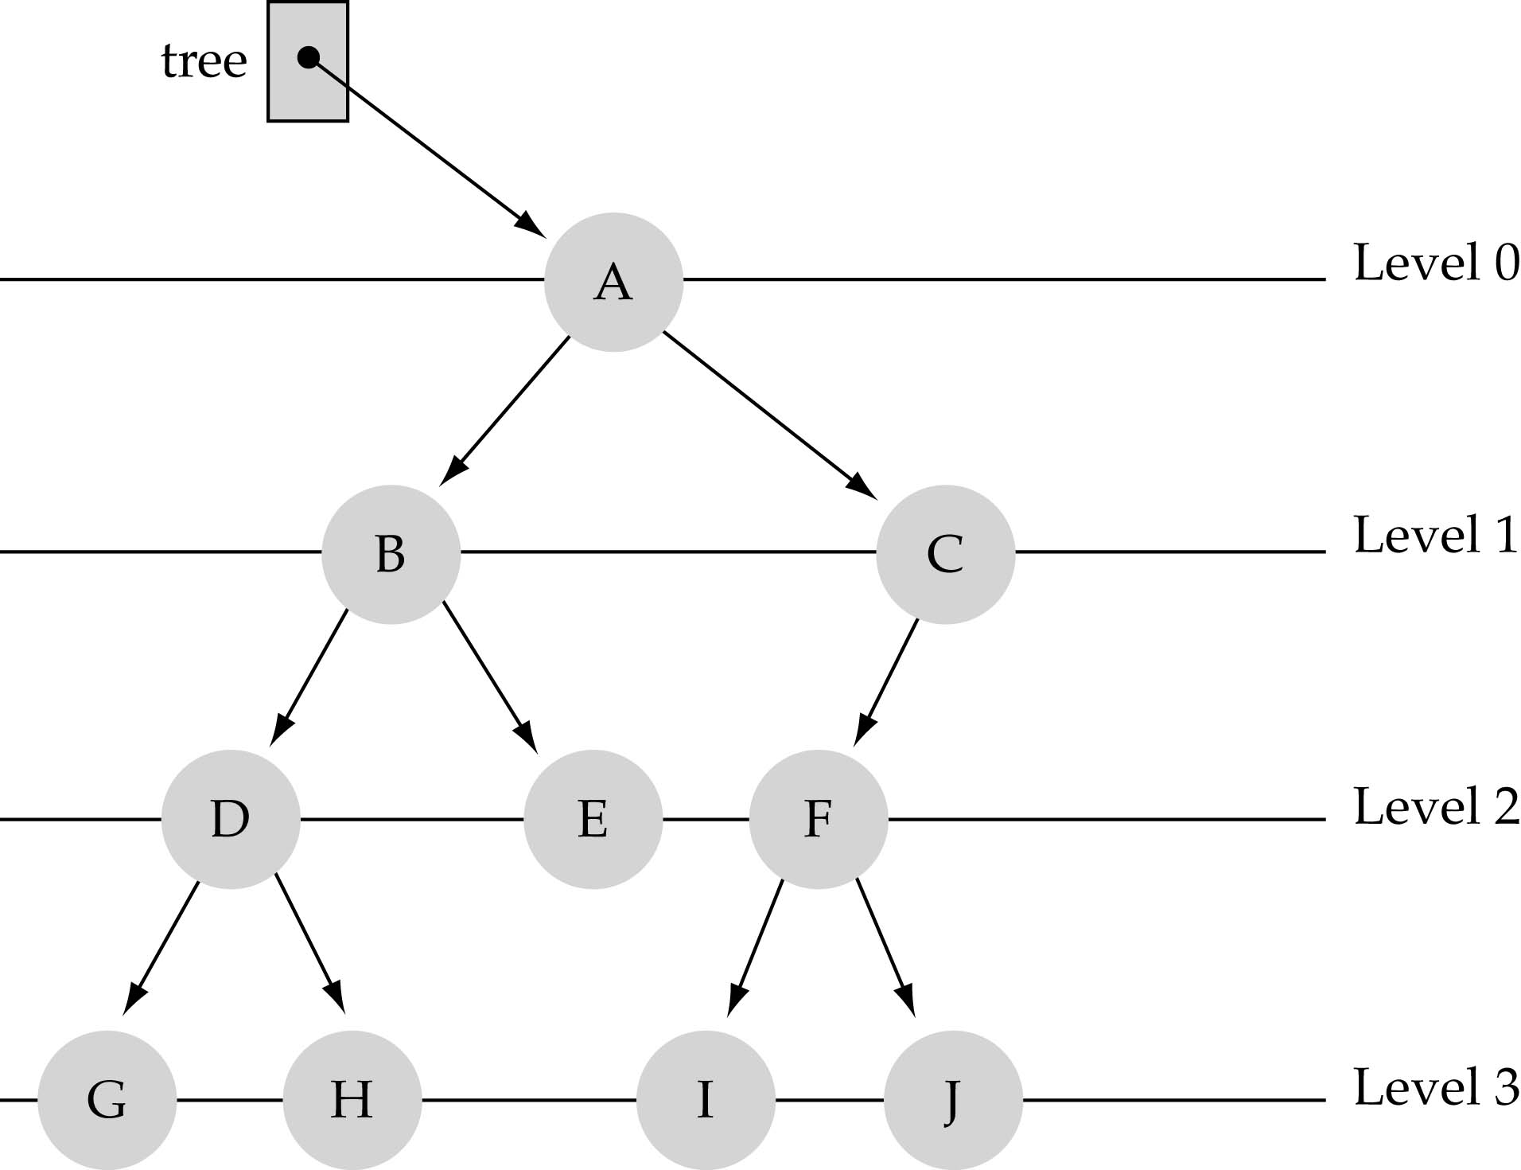
Trees
www.hndit.com
A, B, C, H are internal nodes
The depth (level) of E is 2
The height of the tree is 3
The degree of node B is 2

Slide 23
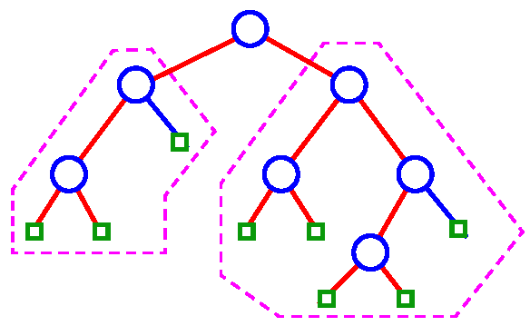
Binary Tree
www.hndit.com
Binary tree: ordered tree with all internal nodes of degree 2

Slide 24
Representing Rooted Trees
www.hndit.com
BinaryTree:
  Parent: BinaryTree
  LeftChild: BinaryTree
  RightChild: BinaryTree
Root
∅
∅
∅
∅
∅
∅
∅
∅
∅
∅
∅

Slide 25
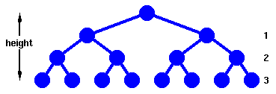
B-Tree
www.hndit.com

Slide 26
Binary Trees
www.hndit.com
Every node in a binary tree can have at most two children.
The two children of each node are called the left child and right child corresponding to their positions.
A node can have only a left child or only a right child or it can have no children at all.
Left child is always less that its parent, while right child is greater than its parent.

Slide 27
Binary Trees
www.hndit.com
Property1: each node can have up to two successor nodes (children)
  The predecessor node of a node is called its parent
  The "beginning" node is called the root (no parent)
  A node without children is called a leaf
Property2: a unique path exists from the root to every other node

Slide 28
Binary Search Trees
www.hndit.com
Binary Search Tree Property:
In a binary search tree,
the left subtree contains key values less than the root
the right subtree contains key values greater than or equal to the root.
Each subtree is itself a binary search tree.

Slide 29
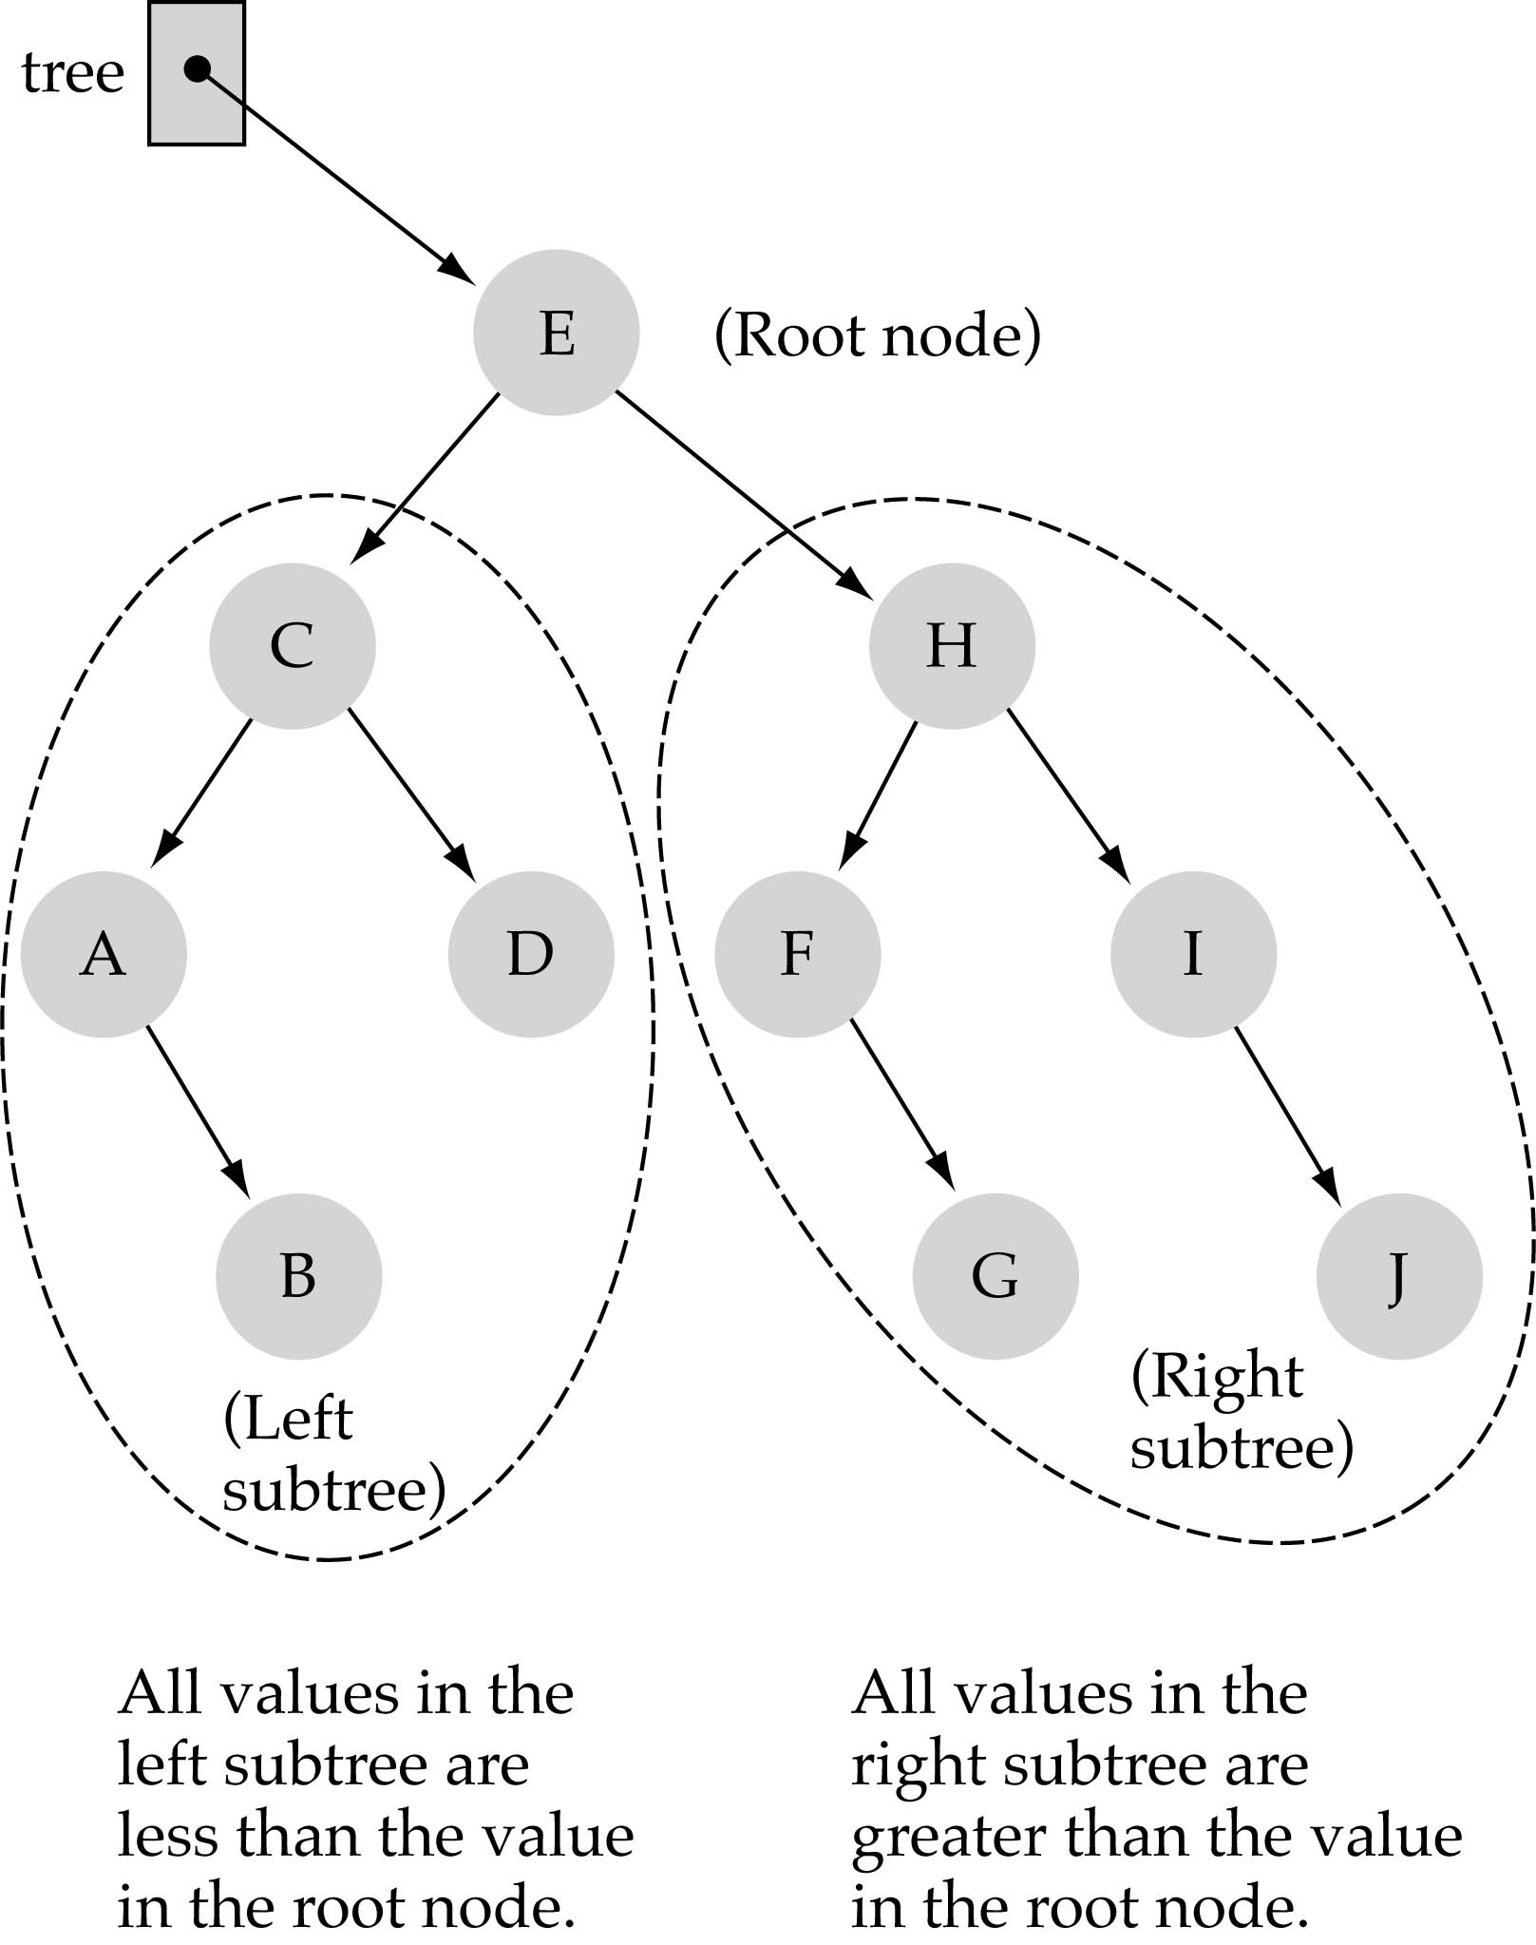

Slide 30
Searching a binary search tree
www.hndit.com
(1) Start at the root
(2) Compare the value of the item you are searching for with the value stored at the root
(3) If the values are equal, then item found; otherwise, if it is a leaf node, then not found

Slide 31
Searching a binary search tree (cont.)
www.hndit.com
(4) If it is less than the value stored at the root, then search the left subtree
(5) If it is greater than the value stored at the root, then search the right subtree
(6) Repeat steps 2-6 for the root of the subtree chosen in the previous step 4 or 5
Is this better than searching a linked list?
Yes !! ---> O(logN)

Slide 32
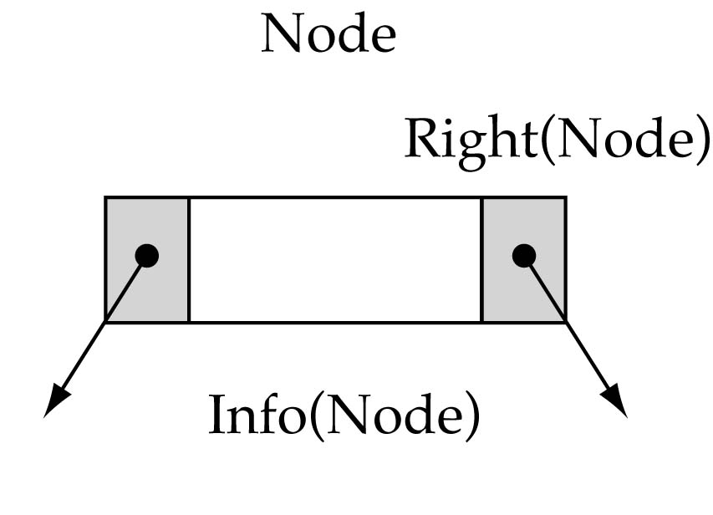
Tree node structure
www.hndit.com
struct TreeNode {
ItemType info;
TreeNode* left;
TreeNode* right;
};

Slide 33
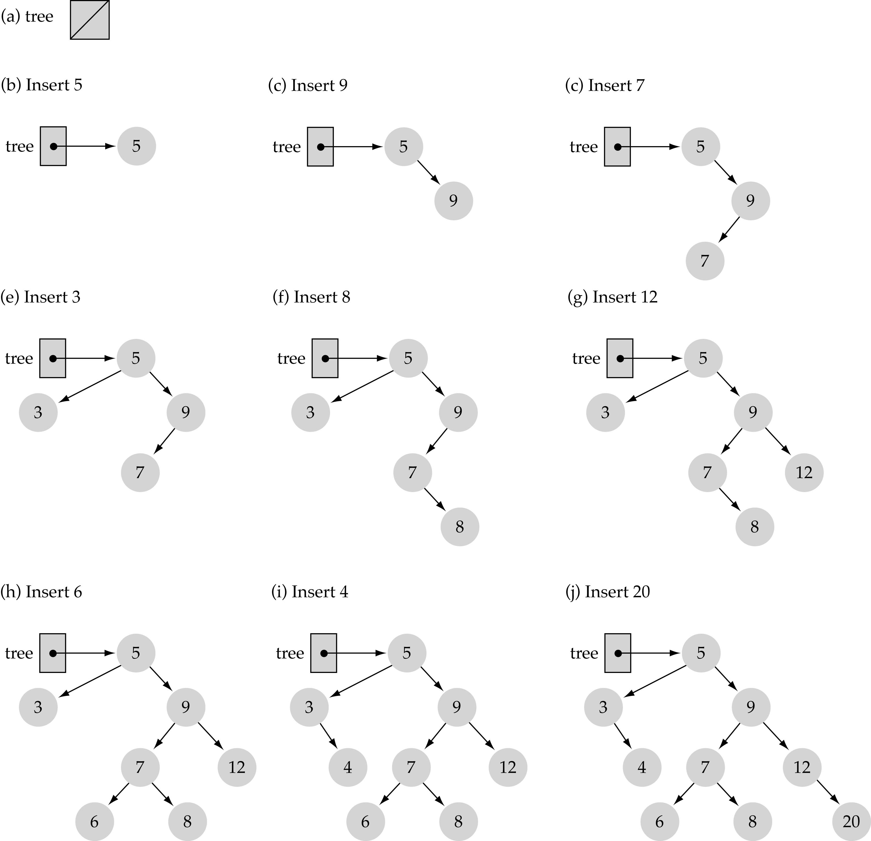
Function InsertItem
Use the binary search tree property to insert the new item at the correct place

Slide 34
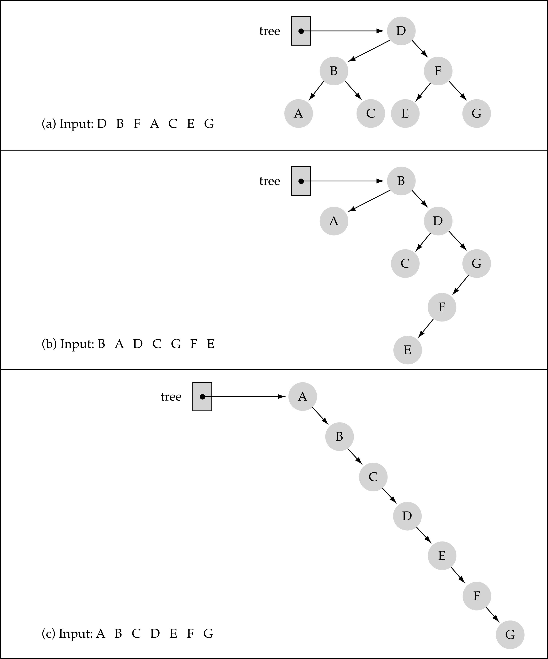
www.hndit.com
Does the order of inserting elements into a tree matter?
(cont.)

Slide 35
Function DeleteItem
www.hndit.com
First, find the item; then, delete it
Important: binary search tree property must be preserved!!
We need to consider three different cases:
(1) Deleting a leaf
(2) Deleting a node with only one child
(3) Deleting a node with two children

Slide 36
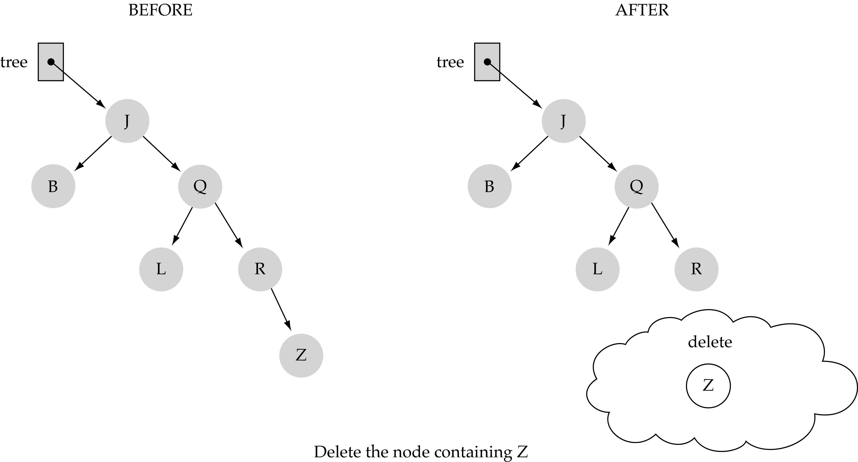
(1) Deleting a leaf
www.hndit.com

Slide 37
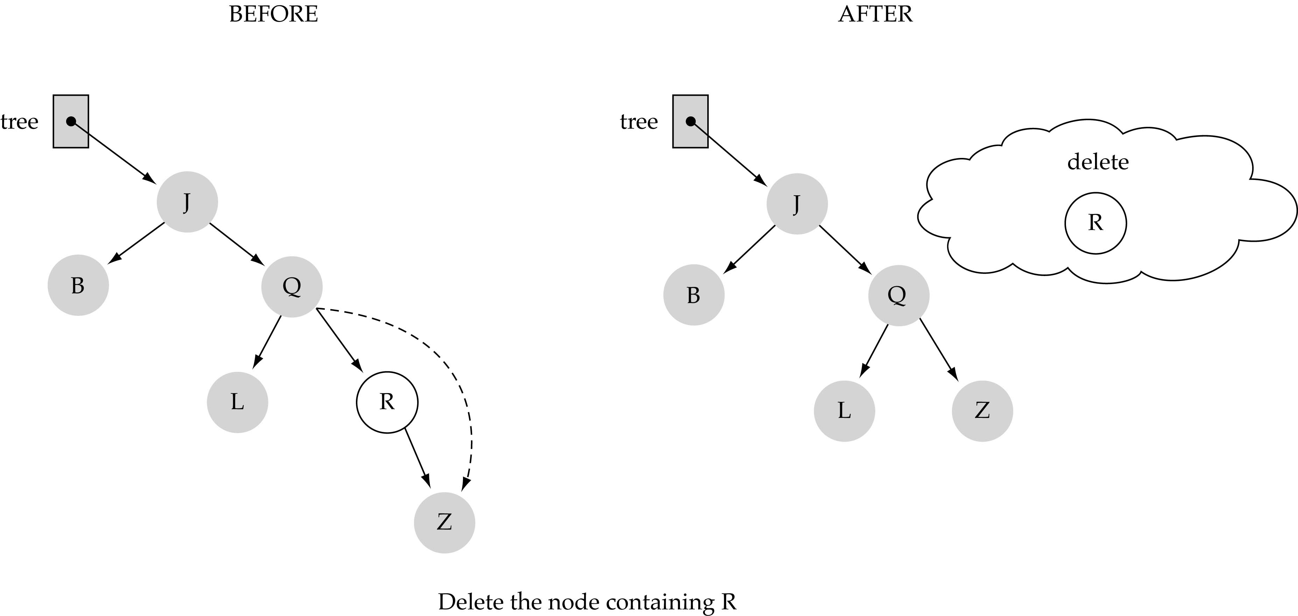
(2) Deleting a node with only one child
www.hndit.com

Slide 38
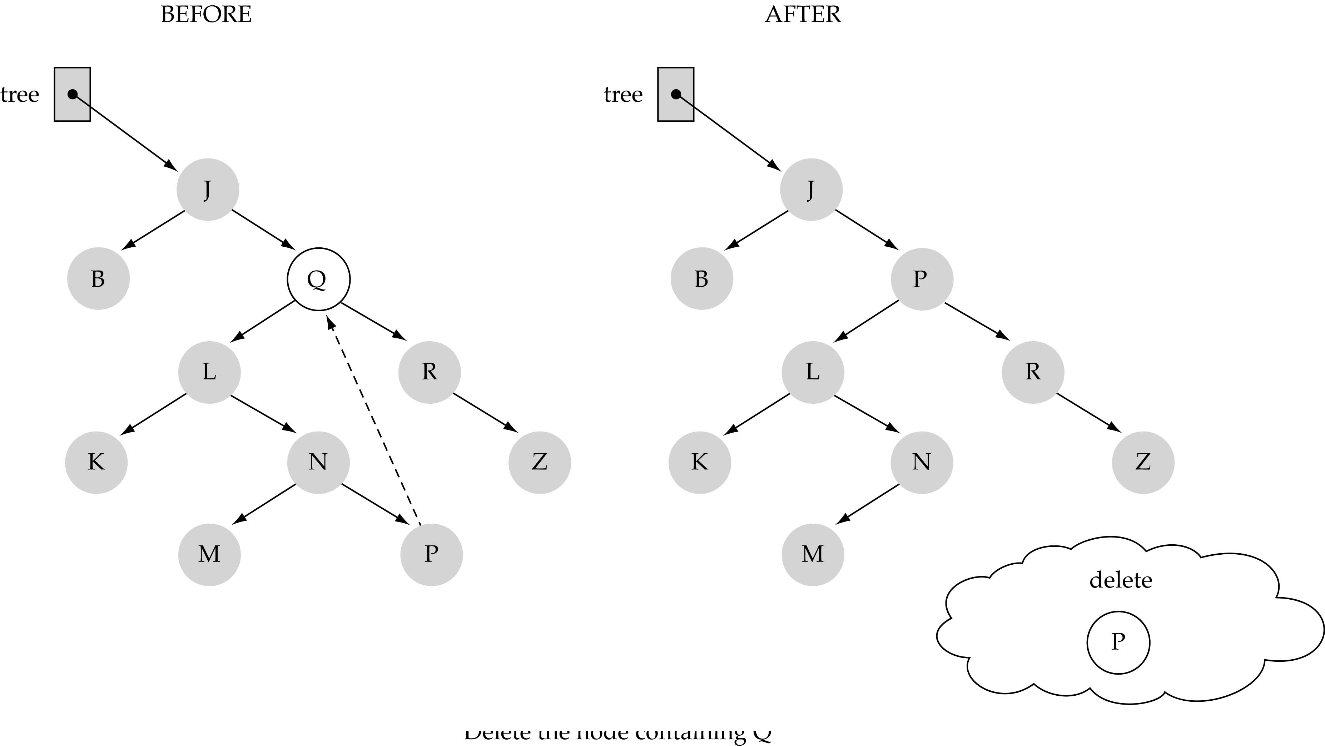
(3) Deleting a node with two children
www.hndit.com

Slide 39
(3) Deleting a node with two children (cont.)
www.hndit.com
Find predecessor (it is the rightmost node in the left subtree)
Replace the data of the node to be deleted with predecessor's data
Delete predecessor node

Slide 40
Representing Tree in C++
www.hndit.com
Similar to Linked List but with 2 Links
  Store the nodes at unrelated locations in memory and connect them using references in each node that point to its children.
Can also be represented as an array, with nodes in specific positions stored in corresponding positions in the array.

Slide 41
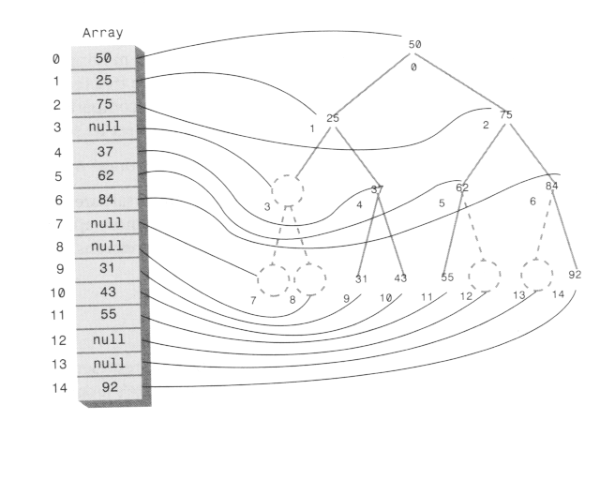
Array implementation
www.hndit.com

Slide 42
Binary Tree Definition
www.hndit.com
T is a binary tree if either:
  T has no nodes, or
  T is of the form:
R
    where R is a node and T_{L} and T_{R} are both binary trees.
T_{L}
T_{R}
  if R is the root of T then :
    T_{L} is the left subtree of R - if it is not null then its root is the left child of R
    T_{R} is the right subtree of R - if it is not null then its root is the right child of R

Slide 43
Full Binary Trees
www.hndit.com
In a full binary tree:
  All nodes have two children except leaf nodes.
  All leaf nodes are located in the lowest level of the tree.
A
B
C
D
E
F
G

Slide 44
Complete Binary Trees
www.hndit.com
In a complete binary tree:
  All nodes have two children except those in the bottom two levels.
  The bottom level is filled from left to right.
A
B
C
D
E
F
G
H
I
G

Slide 45
Binary Search Trees
www.hndit.com
F
A binary search tree represents a hierarchy of elements that are arranged by size:
  For any node n:
    n's value is greater than any value in its left subtree
    n's value is less than any value in its right subtree
D
I
B
E
H
K
A
C
G
J

Slide 46
Binary Expression Trees
www.hndit.com
A binary expression tree represents an arithmetic expression:
  For any node n:
    if n is a leaf node:
      it must contain an operand.
    if n is not a leaf node:
      it must contain an operator.
      it must have two subtrees.
*
+
-
a
b
c
d
This tree represents the expression:
    (a + b) * (c -d) or
    a b + c d -*

Slide 47
Maximum Number of Nodes in BT
www.hndit.com
The maximum number of nodes on level i of a binary tree is 2^{i-1}, i>=1.
The maximum nubmer of nodes in a binary tree
of depth k is 2^{k}-1, k>=1.
i-1

Slide 48
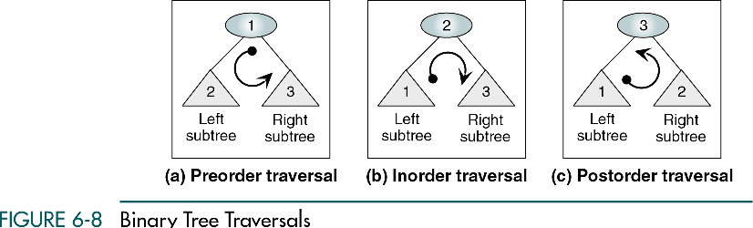
Traversing the Tree
www.hndit.com
There are three possible traversals of binary trees that differ only in the order that they perform the 3 basic operations.
Three simple ways to traverse a tree:
  Inorder
  Preorder
  Postorder

Slide 49
Inorder Traversing
www.hndit.com
Inorder traversal will cause all the nodes to be visited in ascending order.
Steps involved in Inorder traversal (recursion) are:
-- Call itself to traverse the node’s left subtree
-- Visit the node (e.g. display a key)
-- Call itself to traverse the node’s right subtree.

Slide 50
Tree Traversal (continued)
www.hndit.com
Sequence of preorder traversal: e.g. use for infix parse tree to generate prefix
  -- Visit the node
  -- Call itself to traverse the node’s left subtree
  -- Call itself to traverse the node’s right subtree
Sequence of postorder traversal: e.g. use for infix parse tree to generate postfix
  -- Call itself to traverse the node’s left subtree
  -- Call itself to traverse the node’s right subtree
  -- Visit the node.

Slide 51
Inorder Traversal
www.hndit.com
inorder(binTree tree){
// inorder traversal of tree
if(tree != null){
inorder(left subtree of tree)
print tree's data
inorder(right subtree of tree)
}
}
*
+
-
a
b
c
d
For this tree produces:
a + b * c - d

Slide 52
Postorder Traversal
www.hndit.com
postorder(binTree tree){
//postorder traversal of tree
if(tree != null){
postorder(left subtree of tree)
postorder(right subtree of tree)
print tree's data
}
}
*
+
-
a
b
c
d
For this tree produces:
a b + c d - *

Slide 53
Preorder Traversal
www.hndit.com
preorder(binTree tree){
// preorder traversal of tree
if(tree != null){
print tree's data
preorder(left subtree of tree)
preorder(right subtree of tree)
}
}
*
+
-
a
b
c
d
For this tree produces:
* + a b - c d

Slide 54
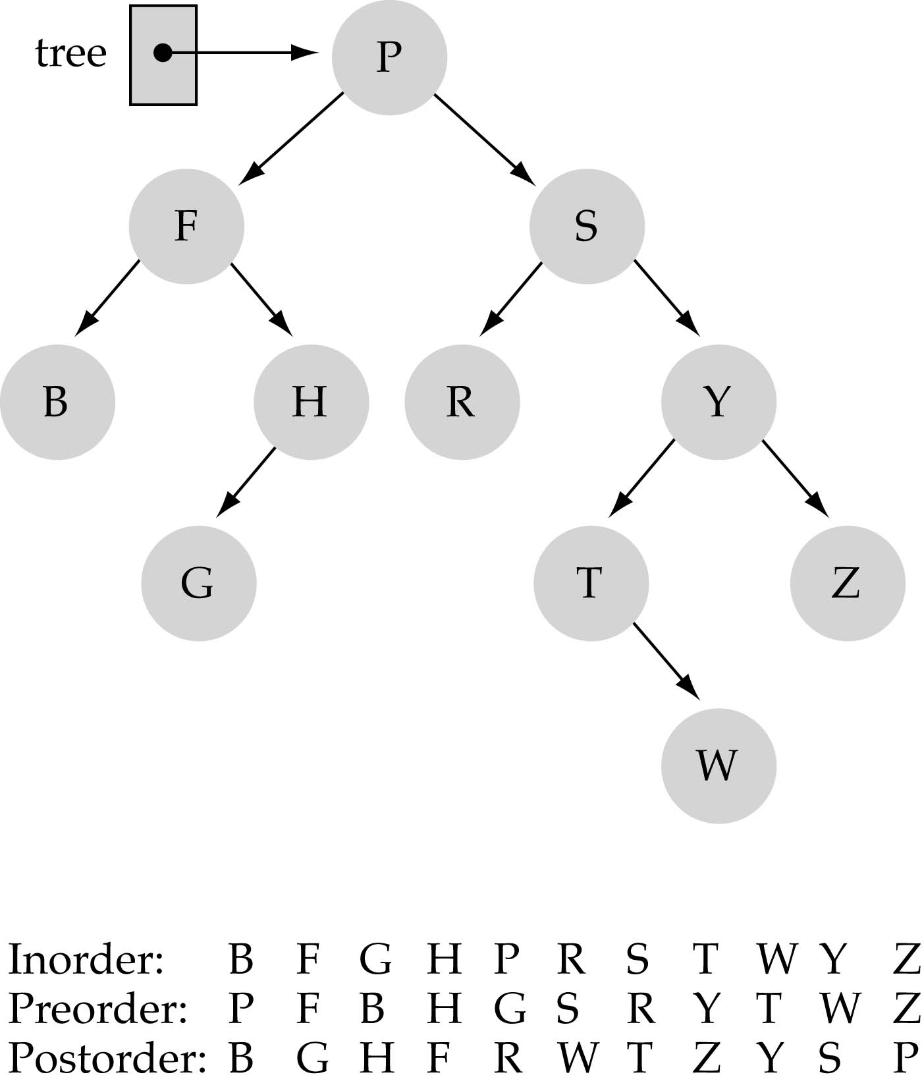
Tree Traversals
www.hndit.com

Slide 55
Finding a Node
www.hndit.com
To find a node given its key value, start from the root.
If the key value is same as the node, then node is found.
If key is greater than node, search the right subtree, else search the left subtree.
Continue till the node is found or the entire tree is traversed.
Time required to find a node depends on how many levels down it is situated, i.e. O(log N).

Slide 56
Inserting a Node
www.hndit.com
To insert a node we must first find the place to insert it.
Follow the path from the root to the appropriate node, which will be the parent of the new node.
When this parent is found, the new node is connected as its left or right child, depending on whether the new node’s key is less or greater than that of the parent.

Slide 57
Finding Maximum and Minimum Values
www.hndit.com
For the minimum,
  go to the left child of the root and keep going to the left child until you come to a leaf node. This node is the minimum.
For the maximum,
  go to the right child of the root and keep going to the right child until you come to a leaf node. This node is the maximum.

